Slide 1


Acropolis Institute of Technology and Research, Indore
Department of Computer Science and Information Technology
B. Tech. VII Semester
MACHINE LEARNING TRAINING PROJECT
[G-13 IMAGE CAPTION GENERATOR ]
Submitted to
Submitted By
Ashutosh chouhan 0827CO191014
Prof. Vandana Kate
Ritik jaiswal 0827CT191046

Slide 2
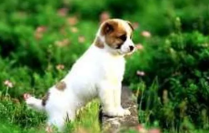
INTRODUCTION
What do you see in the picture ?

Slide 3
Well some of you might say “A white dog In a grassy area", some may say “White dog with brown spots" and yet some others might say "A dog on grass and some pink flowers".
Definitely all of these captions are relevant for this image and there may be some others also . But the point I want to make is : it's so easy for us, as human beings. to just have a glance at a picture and describe it in an appropriate language. Even a 5 year old could do this with utmost ease.
But, can you write a computer program that takes an image as input and produces a relevant caption as output?

Slide 4

MOTIVATION
We must first understand how important this problem is to real world scenarios. Let's see few applications where a solution to this problem can be very useful:

Slide 5
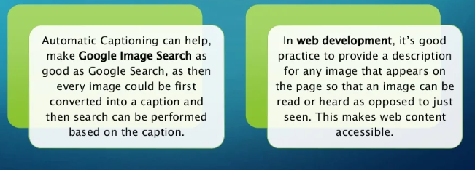

Slide 6
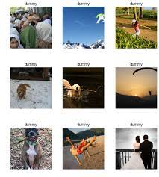
DATA COLLECTION
  There are many open source datasets avalable for this problem, like Flickr 8k (containing8k images), Flickr 30k (containing 30k images), MS coco (containing 180k images), etc.
  But we have used Flicker 8K data set the reason is because it is realistic and relatively small so that you can download it and build models on your workstation

Slide 7
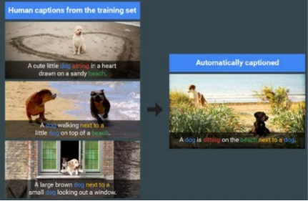
EXAMPLE

Slide 8
IMAGE CAPTIONING
The Image captioning model works on two maln components, a CNN and an RNN. Image Captioning is all about merging the two model to combine their most powerful attributes ie.
CNNs (Convolutional Neural Networks) preserving spatial Information and recognize objects In images
RNN (Recurrent Neural Networks) work well with any kind of sequential data, such as generating a sequence of words
So by merging the two, you can get a model that can find patterns and images, and then use that information to help generate a description of those images.

Slide 9
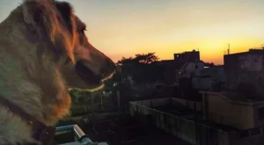
APPROACH
Say you're asked to write a caption that describes this image, how would you approach this task?
Based on how.these objects are placed in an image and their relationship to each other.you might think that a dog is looking at the sky. He is smiling so he might as well be happy. Also he is outside so he might as well be in a park. The sky isn't blue so it might as well be sunset or sunrise.
After collecting these visual observations, you could put together a phrase that describes the image as, "A happy dog is looking at the sky".

Slide 10
CHALLENGES
Recognise objects in the image
Generate a fluent description in natural language

Slide 11
THANK YOU

